Slide 1
N
a
B
t
o
u
Linguistic
Mathematical
r
d
a
l
i
i
s
l
ultiple
t
y
i
Intrapersonal
c
S
p
a
t
i
a
ntelligences
l
Interpersonal

Slide 2
Mathematical-Logical

Slide 3
Linguistic-Verbal

Slide 4
SI
MU
CAL

Slide 5
Spatial

Slide 6
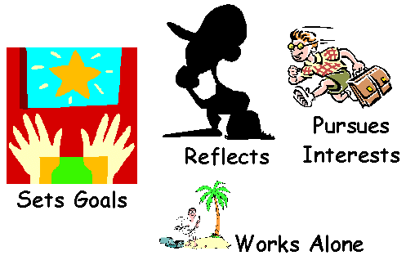
Intrapersonal

Slide 7
pe
rso
Int
er
nal

Slide 8
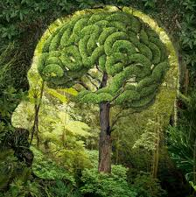
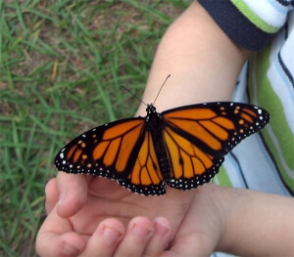
Naturalistic

Slide 9
Bodily-Kinesthetic

Slide 10
Thanks for watching

